Slide 1
THE SECRETARIAL ELECTION PROCESS

Slide 2
Oklahoma Indian Welfare Secretarial Election Summary
The Oklahoma Indian Welfare Secretarial Election, established by the Oklahoma Indian Welfare Act (OIWA) of 1936, is a specific process for federally recognized Indian Tribes and Nations in Oklahoma to organize and adopt governing documents. The key difference between this process and the one under the Indian Reorganization Act (IRA) is the order of approval.

Slide 3
PURPOSE OF ELECTION
The election allows Indian Tribes and Nations to establish or amend their governing documents, which are crucial for exercising their sovereign powers.
Currently, the Pawnee Nation must seek approval from the BIA to conduct an election to change its Constitution.

Slide 4
Secretarial Approval
Before an election, the Secretary of the Interior reviews and approves a proposed Constitution or Amendment to ensure it is consistent with applicable law. This is different from the IRA, which only requires a Secretarial election

Slide 5
PROCEDURE FOR CONDUCTING AN ELECTION
Typically, a Secretarial Election Board, authorized by the Bureau of Indian Affairs (BIA), conducts the election, following established BIA procedures.
The Pawnee Nation, however, has its own rules and procedures for conducting a Secretarial Election.
Recent rule changes require voting by mail unless the Tribe's governing document specifies polling places.

Slide 6

Requesting an Election DAY 0
A federally recognized Tribe or its citizens/members can request the Bureau of Indian Affairs (BIA) to hold a Secretarial election
The Tribe submits a request to the Bureau of Indian Affairs (BIA) for a Secretarial election to vote on specific Constitutional amendments. This request must include all necessary tribal documentation

Slide 7
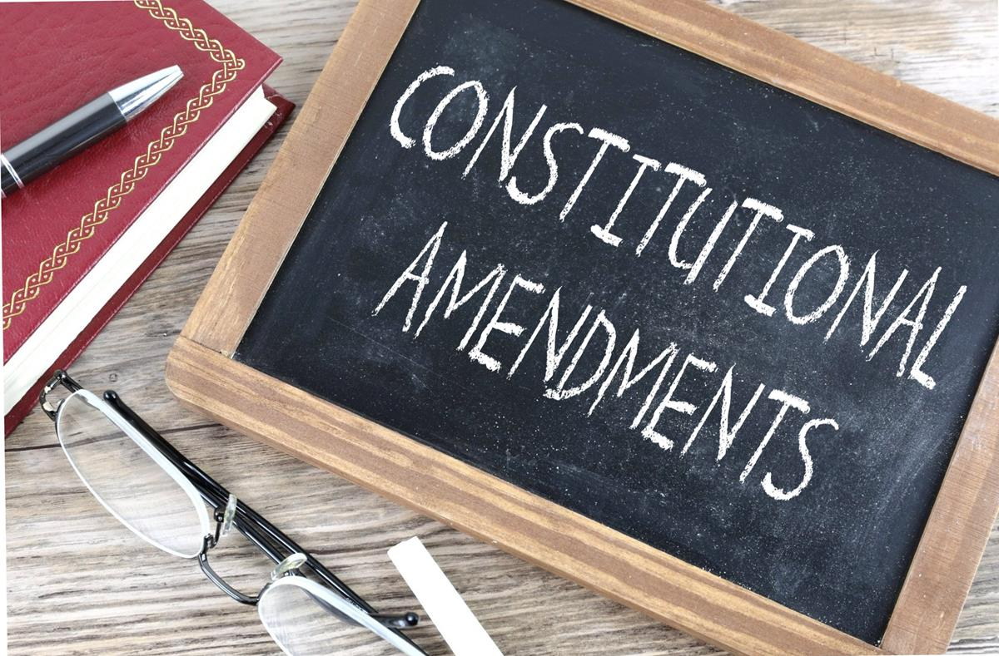
BIA Review (Up to Day 30)
The BIA reviews the proposed amendment to ensure it is not contrary to any federal law. Unlike the initial OIWA Constitution adoption, the Secretary's role is not to approve the content but to authorize the election itself

Slide 8

Call and authorize election
The Authorizing Official directs the Local Bureau Official to call and conduct the election.
Pursuant to the Pawnee Nation Election Act, the election must be conducted within sixty (60) business days.

Slide 9
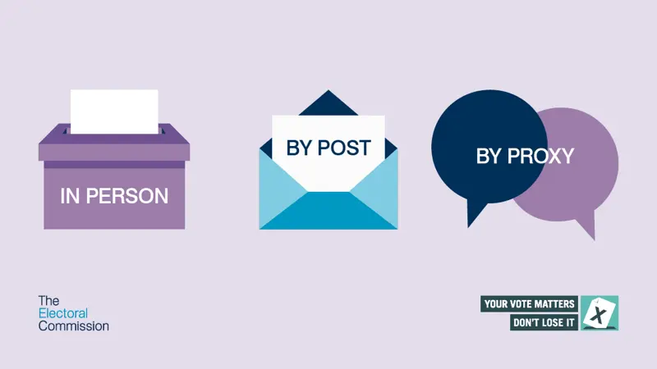
Key Election Requirements
Voting is conducted primarily by mail, though polling places can be used if the Tribe's governing document requires it.
A minimum percentage of eligible voters must cast a ballot, and the specific requirement can be defined by federal statute or tribal documents.
The BIA must adhere to statutory timeframes for calling and holding the election.

Slide 10
Election results
The BIA issues a Certificate of Results of Election. If the document is approved or ratified by the Tribal citizens, the results are certified as a final agency action.

Slide 11
KEY DATES
Establish Election Board: Local Bureau Official appoints a BIA employee as the chair and notifies the Tribe to appoint at least two Tribal citizens/members to the Secretarial Election Board - After authorization.
Board sets election date: The Election Board holds its first meeting to set the election date and other key deadlines - Within 5 days of the Board's appointment.
Mail election notice packets: Election notice packets are sent to all eligible voters, including voter registration forms and instructions - At least 30 days, but no more than 60 days, before the election date.
Voter challenges: Tribal citizens/members can challenge the voter list. The Board resolves all challenges.
Mail out ballots: For the Pawnee Nation, requests for absentee ballots are not needed. All enrolled citizens eighteen (18) years and older are eligible to vote.
Ballot due date: Ballots are due to the Secretarial Election Board by this deadline - Election day (set by the Board).
Certify election results: The Election Board counts the ballots and completes the Certificate of Results of Election - No later than the day after the election.
Review and final action: The BIA Authorizing Official reviews the results, decides on any challenges, and issues the final approval or disapproval of the governing document or amendment - Within 45 days after the election.

Slide 12

Recent rule changes
In 2015, the BIA updated its regulations for Secretarial elections to clarify the process and make it easier for Tribes to remove the requirement for future Secretarial approval of their governing documents

Slide 13
Removing Secretarial Oversight
Tribes that originally organized under the OIWA may amend their governing documents to remove the requirement for Secretarial approval of future amendments
This change requires approval through a Secretarial election

Slide 14
Shift in Funding
Once the requirement for Secretarial approval is removed, all subsequent Tribal elections to amend the governing document are considered Tribal elections. Consequently, the Tribe becomes responsible for the costs associated with these elections, and federal funding is no longer provided for this purpose.
This process allows OIWA tribes to move towards a more self-determined form of governance, aligning with broader policies that favor tribal sovereignty

Slide 15
Subpart E—The Secretarial Election Process Under the Oklahoma Indian Welfare Act (OIWA)
25 CFR Part 81
§ 81.47 How is the OIWA Secretarial election conducted?
After the Chair of the Election Board receives the authorization of the Election, the Chair of the Secretarial Election Board will conduct the election following the procedures set out in §§ 81.19 through § 81.45 of subpart D, or as provided by the Tribes governing documents.

