Slide 1

PAWNEE NATION
Proposed Constitutional Amendments
2026

Slide 2
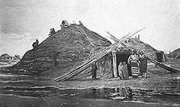
Amendment A
Changing the name of the “Pawnee Nation of Oklahoma" to "Pawnee Nation" throughout the Constitution
Removes all references to “of Oklahoma” when mentioning the Pawnee Nation and the limited scope of the State of Oklahoma, as it omits Pawnee traditional territory. This will include all lands historically claimed by the Pawnee Nation, and not just the current territory in Oklahoma

Slide 3
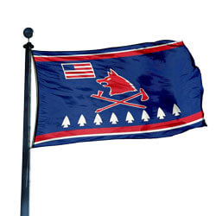
Amendment B
Changing the words "member/membership" to "citizen/citizenship" throughout the Constitution.
Every person who is properly enrolled will now be called citizens of the Nation, rather than members of a specific group.

Slide 4
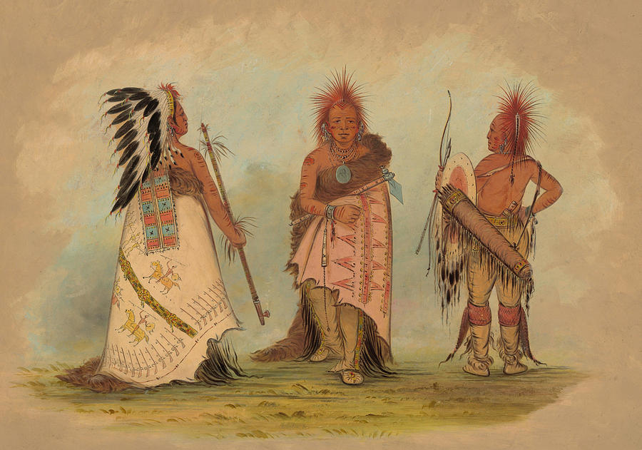
Amendment C
To change the Chief’s council to the proper Pawnee language and dialect
Changing the name of the Chiefs Council from "Nasharo" to "Rêsâru" throughout the Constitution.

Slide 5
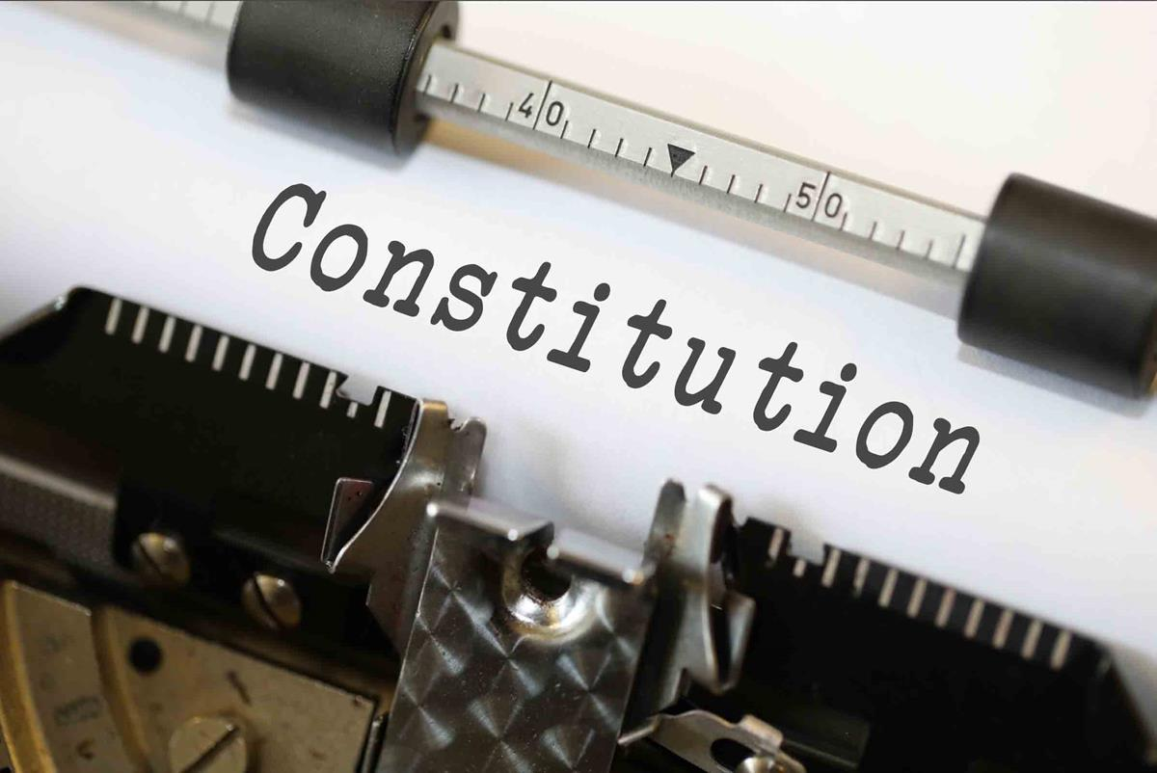
Amendment D
Remove the Secretary of the Department of the Interior from all Articles throughout the Constitution
To remove any and all references to the Secretary reflecting the Nation’s inherent sovereign authority to govern itself

Slide 6
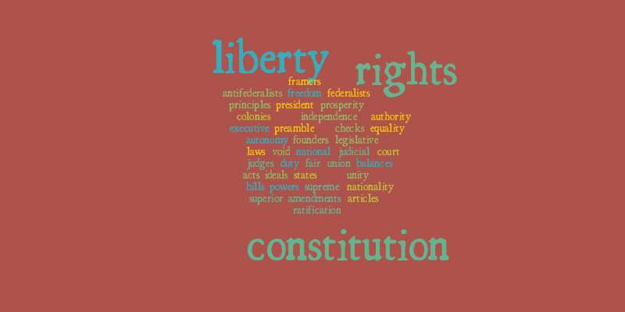
Amendment E
PREAMBLE
(DRAFT)
We, the members citizens of the four confederated bands of Indians, namely, Čawî’, Kitkehaki, Pîtahawirâta and Ckiri Chaui, Kitkehahki, Pitahawirata and Skidi which now constituteof the Pawnee Nation of Oklahoma, with faith in Atî’as Tirawâhat,the purposes of our Supreme Being, with abounding pride in our cultureal, heritage and the and determination to promote through marshaled efforts our cultural, social, economic,al and political advancement, and in exercise of our inherent sovereign authority, do solemnly ordain and establish this Pawnee Nation of Oklahoma and adopt this cConstitution of the Pawnee Nation.pursuant to the Oklahoma Indian Welfare Act of June 26, 1936 (49 Stat. 1967) which shall supersede the constitution approved by the Secretary of the Interior on November 26, 1937, and ratified on January 6, 1938, as amended.

Slide 7
Amendment E– (CLEAN)
We, the citizens of the four confederated bands, Čawî’, Kitkehaki, Pîtahawirâta and Ckiri of the Pawnee Nation, with faith in Atî’as Tirawâhat, abounding pride in our culture, and determination to promote our cultural, social, economic, and political advancement, and in exercise of our inherent sovereign authority, do solemnly ordain and adopt this Constitution of the Pawnee Nation.
To reintroduce and adopt the amended Constitution, define the Nation’s purpose, goals, hopes, and aspirations of the Pawnee people, incorporate Pawnee language and dialect; remove reference to the Oklahoma Indian Welfare Act, and affirm the Nation’s inherent sovereignty authority.
PREAMBLE

Slide 8
Amendment F
Remove the reference to the Nation as an organization and reaffirm that the Nation is a Sovereign Nation, and remove the reference to “of Oklahoma.”
Article I – (Clean)
Article I – (Draft)
The name of this organization Sovereign Nation shall be the “Pawnee Nation of Oklahoma.”
The name of this Sovereign Nation shall be the “Pawnee Nation.”
ARTICLE I - NAME
The name of this organization is ‘The Pawnee Nation of Oklahoma.”

Slide 9

Amendment G ARTICLE II – PURPOSE
(Draft)
Section 1. To secure for the Pawnee Nation of Oklahoma and its members citizens all rights, powers, privileges, and benefits of a sovereign nation.
Section 2. To establish its Jurisdiction and Powers.
The governmental powers of the Pawnee Business Council, acting for the sovereign Pawnee Nation of Oklahoma shall extend to all persons, and to all real and personal property, including but not limited to lands and other natural and cultural resources, and to all waters and air space, within the Indian Country and other lands over which the Pawnee Nation of Oklahoma has jurisdiction. The governmental powers of the Pawnee Nation of Oklahoma shall also extend outside the exterior boundaries of Indian Country to any persons or properties which are, or may be included within the jurisdiction of the Pawnee Nation of Oklahoma.
The Pawnee Nation of Oklahoma is empowered to maintain and operate under anythe laws of the U.S. and/or the Pawnee Nation of Oklahoma’s law and order, and its judicial systems to protect the peace, safety, health, and welfare of the members citizens of the Pawnee Nation of Oklahoma, provided the concepts of separation of powers is maintained.
The Constitution is the supreme law of the Pawnee Nation of Oklahoma and to all persons subject to its jurisdiction. The Pawnee Business Council and all governmental bodies shall exercise its power in a manner consistent with the provisions of this Constitution and the Corporate Charter of the Pawnee Nation of Oklahoma.
Nothing in this Article shall be construed to limit or impair the ability of the Pawnee Nation to exercise jurisdiction based upon its inherent sovereign authority.

Slide 10

Amendment G (Clean)
Revise this Article for easier reading and understanding; to add references to Pawnee Nation cultural resources; and to affirm that nothing in the Constitution will impair or limit the Nation’s inherent right to exercise jurisdiction and sovereign authority.
ARTICLE II - PURPOSE

Slide 11

Amendment H Article III
(Draft)
ARTICLE III - MEMBERSHIP CITIZENSHIP OF THE PAWNEE NATIONTRIBE (DRAFT)
Section 1. The current membership citizenship of the Pawnee Nation of Oklahoma shall consist of: All persons shall be eligible for citizenship in the Pawnee Nation who provided they are:
(A) All persons eEnrolled or entitled to be enrolled and whose name appears on the official annuity (base) roll of the Pawnee Nation of Oklahoma as of February 19, 1937; and
All children born of a lawful marriage between members of the Tribe since the date of said roll;
(B) All children of one-quarter (1/4) or more Pawnee Indian blood born on or after February 9, 1938, of a lawful marriage of an enrolled member.Lineally descended from any enrolled citizen listed on the official annuity (base) roll of the Pawnee Nation as of February 19, 1937.
Section 2. The future membership of the Pawnee Nation of Oklahoma, after the adoption of this Constitution, shall include any individual who applies for membership and possesses at least one-eighth (1/8) degree Pawnee Indian Blood, as amended on January 4, 2003 on Amendment Number 1.
Section 32. The Pawnee Business Council shall have the power to prescribe rules and regulations covering future membershipcitizenship of the Pawnee Nation, including the approval and loss of citizenshipmembership, provided:
i.Such rules and regulations shall be subject to the review of the NasharoRêsâru Council.
ii.Section 3. NoA person shall not be eligible for Pawnee Nation citizenship membership, if enrolled as a citizen or member of another Indian Tribe.
Proposed (Draft)

Slide 12
ARTICLE III - CITIZENSHIP OF THE PAWNEE NATION
Amendment H
(Clean)
To simplify this Article for better clarity and readability, and to integrate the Pawnee language and dialect. It also removes the blood quantum requirement for enrollment in the Pawnee Nation. Eligibility will now be based on lineal descent, provided the descendant is listed on the official annuity (base) roll of the Pawnee Nation as of February 19, 1937.

Slide 13
Amendment I - ARTICLE IV - PAWNEE BUSINESS COUNCIL (Draft)
Section 1. The supreme governing body of the Pawnee Nation of Oklahoma shall be the Pawnee Business Council, which shall consist of eight (8) members.
Section 2. Subject to the limitations imposed by this Constitution and applicable Federal law, the Pawnee Business Council shall exercise all the inherent, statutory, and treaty powers of the Pawnee Nation of Oklahoma by the enactment of legislation, the transaction of business, and by otherwise speaking or acting on behalf of the Pawnee Nation of Oklahoma on all matters which the Pawnee Nation of Oklahoma is empowered to act, including the authority to hire legal counsel to represent the Pawnee Nation of Oklahoma.
Section 3. All acts regarding CitizenshipMembership or Claims or Treaty Rights of the Pawnee Business Council shall be subject to review by the NasharoRêsâru Council in accordance with this Constitution.
Section 4. The present Pawnee Business Council members shall serve until the next regular election or until their successors are elected and installed provided:
The Pawnee Business Council shall provide an election commission to conduct all elections, provided that regular elections are held on the first Saturday in May of each odd numbered year.
No member of the Pawnee Nation of Oklahoma, eighteen (18) years of age or older, shall be denied the right to vote by secret ballot, either in person or by absentee ballot, provided that no write-in votes shall be allowed.
CitizensMembers of the Pawnee Nation of Oklahoma, twenty-five (25) years of age or older, shall be eligible for election to the Pawnee Business Council. Members Citizens of the Pawnee Nation convicted of or having plead guilty to a felony with the exception of a sex crime, violent crime, or misappropriation of funds, regardless of jurisdiction or dishonorably discharged from the Armed Forces of the United States of America are ineligible for no more than seven (7) years for candidacy for elected office as prescribed by law.
Whereas, Aat the first election after the adoption of this Constitution (1999), the President, Treasurer, and the First and Second Council Members shall bewere elected to a four- year term and the Vice-President, Secretary, and Third and Fourth Council members shall bewere elected to a two-year term in order to stagger the terms of office.:
Candidates shall declare the position they are seeking
If there are positions which are vacant due to lack of candidates, those positions shall be considered vacant and filled according to Article VI.
HenceforthThereafter, all members of the Pawnee Business Council shall be elected to a four-year term of office and shall serve until their successors shall be duly installed in office. In cases when a vacancy is being filled to complete an un-expired term due to death, resignation, forfeiture, or recall of a Pawnee Business Council member, a successor will be appointed pursuant to Article VI of this Constitution.
A NasharoRêsâru Council member shall resign his/her position if elected or appointed to the Pawnee Business Council.
A Pawnee Nation of Oklahoma employee shall resign his/her position if elected or appointed to the Pawnee Business Council.
A Pawnee Business Council member shall not be eligible for employment by the Pawnee Nation of Oklahoma during his/her term of office.
Elected members of the Pawnee Business Council shall be inaugurated and sworn into office fourteen (14) calendar days after the Election Day.
Pawnee Business Council records and all related documentation for each outgoing Pawnee Business Council member shall be made available to the newly elected Pawnee Business Council members. Failure to comply shall result in ineligibility to file for candidacy for the Pawnee Business Council for ten (10) years or until records and documents are returned.
Candidates declare the position they are seeking.
If positions are vacant due to lack of candidates, they are considered vacant and filled according to Article VI.

Slide 14
Amendment I– ARTICLE IV - PAWNEE BUSINESS COUNCIL (Continued Draft )
Section 5. All acts of the Pawnee Business Council shall be determined by a majority vote of the membership present, provided five (5) members of the Council shall constitute a quorum to transact business. In the event of a tie, the Presidentchairperson or chairpersonPresident pro tem shall cast the deciding vote.
Section 6. Regular quarterly meetings of the Pawnee Business Council shall be held on the first Saturday in February, June, August and November of each year in a place designated by the Pawnee Business Council, provided:
Special meetings may be called by the President.
Special meetings shall be called by the President within two (2) weeks after receiving a written request, by regular mail or by certified and return receipt mail, from a majority of the occupied Pawnee Business Council positions, provided:
If the President fails to call and conduct a special meeting as requested within two (2) weeks, a majority of the occupied members of the Pawnee Business Council shall be authorized to call and conduct a special meeting by affixing their signatures to a document listing in detail the need for the meeting and citing this Section of the Constitution as their authority to meet.
A minimum of two (2) days’ notice of all meetings, regular or special, shall be published in a newspaper and posted in public view. Provided, that in an emergency, posting in public view for two (2) days shall be deemed sufficient notice. Notice shall include the agenda.
All meetings in this section may be held in-person, virtually, or as a hybrid meeting with both in-person or virtual attendance as may be determined by the Pawnee Business Council.
Section 7. All members of the Pawnee Business Council shall attend tribal constitution orientation classes as prescribed by the Pawnee Business Council.
Section 8. The Pawnee Business Council shall provide an election commission to conduct all elections, provided that regular elections are held on the first Saturday in May of each odd numbered year.

Slide 15
Amendment I(Clean)
Section 1. The supreme governing body of the Pawnee Nation shall be the Pawnee Business Council, which shall consist of eight (8) members.
Section 2. Subject to the limitations imposed by this Constitution and applicable Federal law, the Pawnee Business Council shall exercise all the inherent, statutory, and treaty powers of the Pawnee Nation by the enactment of legislation, the transaction of business, and by otherwise speaking or acting on behalf of the Pawnee Nation on all matters which the Pawnee Nation is empowered to act, including the authority to hire legal counsel to represent the Pawnee Nation.
Section 3. All acts regarding Citizenship or Claims or Treaty Rights of the Pawnee Business Council shall be subject to review by the Rêsâru Council in accordance with this Constitution.
Section 4. The present Pawnee Business Council members shall serve until the next regular election or until their successors are elected and installed provided:
Citizens of the Pawnee Nation, twenty-five (25) years of age or older, shall be eligible for election to the Pawnee Business Council. Citizens of the Pawnee Nation convicted of or having plead guilty to a felony, with the exception of a sex crime, violent crime, or misappropriation of funds regardless of jurisdiction, or dishonorably discharged from the Armed Forces of the United States of America are ineligible for no more than seven (7) years for candidacy for elected office as prescribed by law;
Whereas, at the first election after the adoption of this Constitution (1999), the President, Treasurer, and the First and Second Council Members were elected to a four-year term, and the Vice-President, Secretary, and Third and Fourth Council members were elected to a two-year term in order to stagger the terms of office.
Henceforth, all members of the Pawnee Business Council shall be elected to a four-year term of office and shall serve until their successors shall be duly installed in office. In cases when a vacancy is being filled to complete an unexpired term due to the death, resignation, forfeiture, or recall of a Pawnee Business Council member, a successor will be appointed pursuant to Article VI of this Constitution.
A Rêsâru Council member shall resign his/her position if elected or appointed to the Pawnee Business Council.
A Pawnee Nation employee shall resign his/her position if elected or appointed to the Pawnee Business Council.
A Pawnee Business Council member shall not be eligible for employment by the Pawnee Nation during his/her term of office.
Elected members of the Pawnee Business Council shall be inaugurated and sworn into office fourteen (14) calendar days after Election Day.
Pawnee Business Council records, and all related documentation for each outgoing Pawnee Business Council member shall be made available to the newly elected Pawnee Business Council members. Failure to comply shall result in ineligibility to file for candidacy for the Pawnee Business Council for ten (10) years or until records and documents are returned.
Candidates declare the position they are seeking.
If positions are vacant due to a lack of candidates, they are considered vacant and filled according to Article VI.
Section 5. All acts of the Pawnee Business Council shall be determined by a majority vote of the membership present, provided five (5) members of the Council shall constitute a quorum to transact business. In the event of a tie, the President or President pro tem shall cast the deciding vote.
ARTICLE IV - PAWNEE BUSINESS COUNCIL

Slide 16
Amendment I (ContinuedClean)
Section 6. Regular quarterly meetings of the Pawnee Business Council shall be held on the first Saturday in February, June, August, and November of each year in a place designated by the Pawnee Business Council, provided:
Special meetings may be called by the President.
Special meetings shall be called by the President within two (2) weeks after receiving a written request, by regular mail or by certified and return receipt mail, from a majority of the occupied Pawnee Business Council positions, provided:
If the President fails to call and conduct a special meeting as requested within two (2) weeks, a majority of the occupied members of the Pawnee Business Council shall be authorized to call and conduct a special meeting by affixing their signatures to a document listing in detail the need for the meeting and citing this Section of the Constitution as their authority to meet.
A minimum of two (2) days’ notice of all meetings, regular or special, shall be posted in public view. Provided that in an emergency, posting in public view for two (2) days shall be deemed sufficient notice. Notice shall include the agenda.
All meetings in this section may be held in-person, virtually, or as a hybrid meeting with both in-person or virtual attendance as may be determined by the Pawnee Business Council.
Section 7. All members of the Pawnee Business Council shall attend tribal constitution orientation classes as prescribed by the Pawnee Business Council.
Section 8. The Pawnee Business Council shall provide an election commission to conduct all elections, provided that regular elections are held on the first Saturday in May of each odd-numbered year.
To revise this Article to improve clarity and readability; include Pawnee language and dialect; move the citizens’ right to vote to the appropriate Article (Bill of Rights); and specify eligibility requirements for candidacy, term limits, and meeting procedures.
ARTICLE IV - PAWNEE BUSINESS COUNCIL

Slide 17
Amendment J(Draft) ARTICLE V - DUTIES OF OFFICERS
Section 1. The President of the Pawnee Business Council shall:
Preside preside at all general meetings, meetings of the Pawnee Business Council, joint meetings of the Pawnee Business Council and the NasharoRêsâru Council;,
and all general meetings and shall vVote only in the case of a tie of all general meetings, meetings or acts of the Pawnee Business Council, and joint meetings of the Pawnee Business Council and the Rêsâru Council;
Dutifully support the Constitution and laws of the Pawnee Nation;
Ensure that all decisions of the Pawnee Business Council are faithfully executed, administered, and enforced;
Administer oaths and affirmations when required or permitted;
Be bonded;
Be authorized to countersign checks disbursed by the Treasurer according to the requirements of Article V, Section 4 of this Constitution;
Call Special meetings under the authority granted by Article IV, Section 6 of this Constitution; and
Unless authorized by this Constitution, the President shall not take any action unless directed by the Pawnee Business Council.. The President shall have general supervision of the affairs of the Pawnee Business Council and shall perform all duties pertaining to the office of the President. The President shall administer oaths and affirmations when required or permitted. The President shall be bonded.
Section 2. In the absence of the President, the Vice-President shall perform the duties of that office. In the case of vacancy, the Vice-President shall succeed at once to the office of the President. The Vice-President shall be bonded.
Section 3. The Secretary shall, be responsible for the following duties:
Record the proceedings of all meetings of the Pawnee Business Council and NasharoRêsâru Council, and all special meetings as assigned by the Pawnee Business Council;.
Prepare the agenda for meetings of the Pawnee Business Council;.
Maintain all records and files of the Pawnee Business Council. All records and files of the Pawnee Business Council, except such records as shall be explicitly made exempt by law, shall be public information to any member of the Pawnee Nation of Oklahoma;.
Maintain the Pawnee Nation of Oklahoma official membership roll;.
Attest to enactments of the Pawnee Business Council;.
In absence of the President and Vice-President, call to order regular and special meetings of the Pawnee Business Council until a Chairman pro tem is selected;.
Perform the duties of the Treasurer, in the absence of the Treasurer; and.
The Secretary shall be bonded.
Section 4. The Treasurer shall, be responsible for the following duties:
Receive funds from all sources for which the Pawnee Business Council is held accountable, and maintain financial records which shall reflect actual receipts and disbursements of all funds, and which shall reflect the financial position of the Pawnee Nation of Oklahoma.;
Deposit funds from any and all sources for which the Pawnee Business Council is held accountable in an insured bank or other approved financial institution;.
Disburse by check, the funds from any and all funds for which the Pawnee Business Council authorizes. All checksFunds shall be signeddisbursed by the Treasurer and countersignedapproved according to the hierarchy listed under Article V;. by the President.
An annual independent audit of all funds for which the Pawnee Business Council is held accountable;.
Present financial status reports and budget reports as determined by the Pawnee Business Council;.
Perform the duties of the Secretary, in the absence of the Secretary;.
The Treasurer shall be bonded; and.
If the Treasurer fails to fulfill his or her Constitutional or statutory duties of the office of the Treasurer, funds may be jointly disbursed by two (2) officers of the Pawnee Business Council.

Slide 18
Amendment J (Clean)
To clean up this Article to make it easier to read and understand; incorporate Pawnee language and dialect; and clarify Officers’ duties and responsibilities
ARTICLE V - DUTIES OF OFFICERS

Slide 19
Amendment K (Draft) ARTICLE VI - VACANCIES
Section 1. - In the event of a Presidential vacancy, the Vice-President shall temporarily vacate theirhis/her office and fulfill the duties of the office of President until another pPresident is elected by a majority of Pawnee Nationtribal voters in a specially called election. The Business Council shall elect from the current council membership citizenship a Temporary Vice President to serve until the next President is elected by a majority of Pawnee Nationtribal voters in a specially called election, at which time the Temporary Vice President shall return to his/her previous position.
Section 2. – If the offices of the President and Vice President are vacant, the Treasurer shall temporarily vacate his/hertheir office and fulfill the duties of the President, and the sSecretary shall temporarily vacate his/hertheir office and fulfill the duties of the Vice President. The Business Council shall elect from the current council membership citizenship a Temporary Treasurer and a Temporary Secretary until the next President and Vice President are elected by a majority of Pawnee Nationtribal voters in a specially called election, at which time the Temporary Treasurer and Temporary Secretary shall return to his/hertheir previous position.
Section 3. – If the offices of the President, Vice President, and Treasurer are vacant, the Secretary shall temporarily vacate his/hertheir office and fulfill the duties of the President. The Business Council shall elect from the current council membershipcitizenship a Temporary Vice President, Temporary Treasurer, and Temporary Secretary until the next President, Vice President, and Treasurer are elected by a majority of Pawnee Nationtribal voters in a specially called election, at which time the Temporary Vice President, Temporary Treasurer and Temporary Secretary shall return to his/hertheir previous position.
Section 4. – Notwithstanding Article IV4, Section 5, if four (4) or more positions are vacant, a quorum shall consist of all of the remaining Council members. If all officer positions are vacant, any remaining council members may call a special Business Council meeting, at which time that cCouncil member shall chair, and the remaining council shall elect officers.
Section 5. – If a vacancy occurs in a First, Second, Third, or Fourth Business Council member position before the last six (6) months of a term, it shall be filled by a majority of Pawnee Nationmember voters in a specially called election.
Section 6. – If a vacancy occurs in a First, Second, Third, or Fourth Business Council member position in the latter six (6) months of that term, that position shall remain vacant until the next general election.
Section 7. – If a vacancy occurs in any Business Council position in the six (6) months prior to a general election, the specially called election shall be held with the general election.
Section 8. – Any successful candidate who is elected in a special election shall serve only the remaining term of that vacant position.
Section 9. – Unless sSections 6 and& 7 apply, the eElection Board shall set and conduct a special election within sixty (60) days, but not before thirty (30) days, after a position is vacant.
Section 10. – A position is vacant when:
Subject to an effective date, a resignation is received in writing by the Office of the pPresident;
Vacant pursuant to Article VII, Section 1;One
Death;
Recall;
Removal; or
A suspension is imposed under Article VII, Section 3, in which case a specially called election is not required if the Business Council finds that suspension is likely to be resolved within six (6) months. If the Business Council finds that the suspension is likely to be longer than six (6) months, they may call a special election may be called. If the suspension is removed, the person elected in the special election shall step down and the suspended Business Council Member shall retake his/hertheir position.

Slide 20
Amendment K (Clean)
To clean up this Article to make it easier to read and understand.
ARTICLE VI - VACANCIES

Slide 21
Amendment L - ARTICLE VII - FORFEITURE, RECALL, SUSPENSION, REMOVAL (DRAFT)
Section 1. Forfeiture
If a member of the Pawnee Business Council fails or refuses to attend two (2) regularly called quarterly or special meetings per year from the date of his/her oath of office, unless excused by majority vote of the Pawnee Business Council President for illness or other causes for which the member cannot be held responsible, his/her seatoffice shall be declared forfeited by a resolution of the Pawnee Business Council and become vacant.
Any the vacancy shall be filled consistent with Vacancy provisions of this Constitution.
Section 2. Recall
A petition for recall of any member of the Pawnee Business Council shall be:
fFiled with the Pawnee Nation Election Commission with a statement alleging specific facts and dates of actions or inactions by the Pawnee Business Council Member subject to recall, including the Article of the Pawnee Nation Constitution that was violated;
Vverified by the Enrollment Department that thirty- five percent (35%) of the number of voters who voted in the last regular election signed the petition; and
Ssigned and include the following information for all individual signatures: full name, date of birth, and signature.
pay a filing fee not to exceed fifty percent (50%) of the total cost of the last regular election payable to the Election Commission.
Individual petitions shall be filed for each Pawnee Business Council Member who is subject to recall.
The petitioner shall be required to pay a filing fee of fifty percent (50%) of the total cost of the last regular election payable to the Election Commission for each individual Pawnee Business Council Member being recalled.
Once requirements of Section 2 (A)(1-3) and (C) have been completedAfter receipt of the verified recall petition, the Election Commission shall call and hold a recall election within sixty (60) business days, but not before thirty (30) business days.
Notice of the recall shall be sent to all eligible voters prior to the recall election.
The Rrecall shall be effective when only if a majority of those voting shall vote in favor of such a recall and that at least fifty percent (50%) + one (1) of the number voting, in the previous election votes in favor of the recall election.
Once a member has faced a recall attempt, no further recall action shall be brought against that member until at least twelve (12) consecutive months have passed. No member of the Pawnee Business Council shall be subject to a recall action within the first twelve (12) months of that member’s term. A recall proceeding may not be initiated against a Council Member whose term expires within six (6) months.
A maximum of three (3) Council Members may be recalled at a time.
Section 3. Suspension
A Pawnee Business Council mMember shall be suspended from the Business Council without compensation whenif:
cChargesd are pending for with a felony criminal offense;, and
Anthat offense would be cause for removal as defined in Section 4. (C)iv.(a1-6);, and
tThe charging jurisdiction where the charges are pending guarantees equalsimilar civil rights and due process as is guaranteed under within the Pawnee Nation Constitution.
The suspension shall be effective from the date of the filing of the charges until dismissed.
It is the duty of the defendant Business Council Member to immediatelytimely notify the Business Council and the Attorney General of any pending felony the charges.
A suspended Business Council Member is excused from attending meetings and other official dutyduties during the suspension.
NoAny vote cast or other official action taken after such charges have been filed shall be valid, but taking such official action while under suspension shall be valid and will constitute the crime of unofficial misconduct.
The Business Council may by majority vote, with the subject member abstaining, lift the suspension if it finds that the requirements of paragraph (i) are not met.
The suspended Business Council Member may bring a declaratory judgment action in Pawnee Nation Tribal Court to challenge the application of this Section.
If the Court dismisses the pending felony charges are dismissed, because the defendant is found innocent, the suspension shallis automatically be removed, and all withheld compensation shall be paid without interest.

Slide 22
Amendment L ARTICLE VII - FORFEITURE, RECALL, SUSPENSION, REMOVAL (CONTINUED DRAFT)
Section 4. Removal of Pawnee Business Council Members
Removal for Cause –A Pawnee Business Council members may be removed for cause by a petition for removal filed in Pawnee Nation District Court with the right of appeal to the Pawnee Nation Supreme Court.
A petition for removal may be filed only;on behalf of the Pawnee Nation by resolution of the Pawnee Business Council.
by the Attorney General, or
by Resolution of the Pawnee Business Council, or
by any individual or individuals who deposits $10,000 in cash or bond with the court clerk.
Removal for cause includes but is not limited to:
A felony conviction by any Tribal, Federal, or State Court while serving on the Pawnee Business Council;
Conviction means a final conviction or a plea of no contest or guilty, regardless of beingwhether or not dismissed, suspended, pardoned, or expunged, and irrespective of whether it is denominated a felony, misdemeanor, or otherwise.
Converting Pawnee Nation property or monies for personal use, or financial gain or profit;
Willful neglect or refusal to fulfill Constitution or statutory duties;
Official misconduct in office or by abusing the lawful authority of an elected official;
Official misconduct in office shall include but is not limited to harassment or unfair treatment of a Pawnee Nation citizen or employee by a Council Member due to religion, sex, age, or disability;
Physical or mental incapacity; or
Cessation of citizenship in the Pawnee Nation.
Cause if defined as:
(a) conviction of any of the following offenses in any legitimate governmental jurisdiction:
A. Fraud
Making false representation
Knowledge of such false representation by the perpetrator
Reliance on the false representation by the person defrauded
An intent to defraud
The actual act of committing fraud
Passing bad checks
Knowingly possessing stolen property
B. Evil Intent
Arson
Blackmail
Embezzlement
Extortion
False pretenses
Forgery
Fraud
Larceny (grand or petty)
Crimes against property
Malicious destruction of property
Receiving stolen goods (with guilty knowledge)
Robbery
Theft (when it involved the intention of permanent taking)
Transporting stolen property (with guilty knowledge)
Crimes against Governmental authority
Bribery
Counterfeiting
Fraud against revenue or other governmental functions
Mail fraud
Perjury
Harboring a fugitive from justice (with guilty knowledge)
Tax evasion (willful)
Carry a concealed weapon
The grounds for removal shall be set forth with specificity in the petition for removal and the Pawnee Desertion from the Armed Forces
Dishonorable Discharge from the Armed Services
Failure to report for military induction
Drunk driving
Habitual drunkenness
Escape from prison
Gambling violations
Controlled Dangerous Substances violations
Liquor violations
Vagrancy
E. Crimes committed against person, family relationship, and sexual morality
Abandonment of a minor child (if willful and resulting in the destitution of the child)
Assault
Assault with intent to kill, commit rape, commit robbery or commit serious bodily harm
Assault with a dangerous or deadly weapon
Contributing to the delinquency of a minor
Gross indecency
Incest
Kidnapping
Lewdness
Manslaughter
a. Voluntary
b. Involuntary, where the statue requires proof of recklessness
Mayhem
Murder
Pandering
Prostitution
Rape (including “Statutory rape”)
Sodomy
Libel/Slander
Mailing an obscene letter
Crimes attempting, aiding and abetting, accessories, and conspiracy
an attempt to commit a crime listed in this Section,
Aiding and abetting in the commission of a crime listed in this Section,
Being an accessory (before or after the fact) in the commission of a crime listed in this Section,
Taking part in conspiracy (or attempting to take part in a conspiracy) to commit a crime listed in this Section.
(b) Willful neglect or refusal to fulfill statutory duties.
Intentional conduct reflecting very negatively on the dignity and integrity of the tribal government.
Business Council Member shall be suspended from office until the Court rules on the petition.
Court Review
The Pawnee Nation District Court shall review the removal petition in a new trial.
An The Judge must hold an initial hearing must be held within thirty (30) days of receipt of the petition with a decision reached by the Court and resolve the case within ninety (90) days.
The petitioner must prove the allegations contained in the petition facts by clear and convincing evidence. Any party to the case shall have a right to appeal.
Before the Court rules on a petition for removal, the Court shall provide due process to each party, including:
A copy of the petition;
The right to respond to the petition; and
The right to present witnesses and other evidence in his/her defense.
If the Court finds grounds for removal as stated in the petition do exist, the Pawnee Nation shall be awarded reasonable costs and expenses, including attorney fees, not to exceed Ten Thousand Dollars ($10,000), and any other relief that the Court deems fair and reasonable.
If the Court finds grounds for removal as stated in the petition do not exist, Tthe defending Council member shall be reinstated to the Pawnee Business Council and awarded reasonable costs and expenses, including may be represented by Counsel. If the Court denies the petition then the defending Council member shall be awarded costs and attorney fees, not to exceed Ten Thousand Dollars ($10,000).00, and any other relief that the Court deems fair and reasonable.
The costs and expenses, including attorney fees, shall be paid from Pawnee Nation funds.
All parties may be represented by an attorney of his/her choosing, provided at his/her own expense for the purposes of this Section.
Either party may seek an appeal of the decision of the District Court by filing an appeal with the Pawnee Nation Supreme Court.
No Pawnee Business Council member shall be subject to removal If the petition was filed by Business Council or the Attorney General the cost of attorney fees shall be paid from tribal funds. If the petition was filed by an individual the cost of attorney fees shall be paid from the deposit. An exonerated Council member charged under paragraph (iv) (b) or (iv) (c) of this Section shall not be charged again under such paragraph until more than twelve (12) months have passed since the previous petition for removal was filed.
A Pawnee Business Council member removed from office shall not be prohibited from running or holding office again at any time in the future, provided they meet eligibility requirements in Article IV.
If a petition filed by individual(s) is successful then their $10,000 deposit shall be refunded. If the attorney fees of a winning defendant are less than $10,000 then the balance shall be refunded.

Slide 23
Amendment L (Clean)
To clean up this Article to make it easier to read and understand; remove the list of enumerated crimes under Section 4; clarify the processes and procedures for recall, suspension, and recall; define removal for cause; and set forth petition for removal requirements.
ARTICLE VII - FORFEITURE, RECALL, SUSPENSION, REMOVAL

Slide 24

Amendment M (Draft)
ARTICLE VIII - NASHARORÊSÂRU COUNCIL (DRAFT)
Section 1. The NasharoRêsâru Council shall consist of eight (8) members with a quorum of five (5) to transact business. Each band shall have two (2) representatives on the NasharoRêsâru Council selected by the members of the tribal bands, Čawî’Chaui, KitkehakiKitkehahki, PîtahawirâtaPitahawirata and CkiriSkidi. The NasharoRêsâru Council shall have the right to review all acts of the Pawnee Business Council regarding the Pawnee Nation of Oklahoma membershipcitizenship and Pawnee Nation of Oklahoma claims or rights growing out of tTreaties between the Pawnee Nation of Oklahoma and the United States, provided:
Such acts of the Pawnee Business Council shall be valid and valid unless formally disapproved by the NasharoRêsâru Council within thirty (30) days after suchthe acts are referred to the latter Rêsâru Council;
Where such acts are disapproved by the NasharoRêsâru Council, the Pawnee Business Council may submit them to a referendum vote by of the Pawnee Nation citizens of Oklahoma and the-y acts shall become valid and effective if approved by a majority vote of the adult citizens members voting in person or by absentee ballot; provided, that, at least fifty (50) of those qualified to vote shall cast ballots in such election.
Section 2. The Bands of the Pawnee Nation of Oklahoma shall elect itstheir respective representative under rules and regulations prescribed by the Chiefs of each Band. The representatives selected shall serve until the next regular selection of members of the NasharoRêsâru Council.
Section 3. Vacancies in the membership of the NasharoRêsâru Council shall be filled under rules and regulations prescribed by the NasharoRêsâru Council.
Section 4. The NasharoRêsâru Council shall have the power to establish its own offices and to designate its own officers, to fix isset its own meeting days, and to adopt its own rules of procedure; provided a quorum is present to transact business. Records of the proceedings of this body shall be kept.
Section 5. All members of the NasharoRêsâru Council shall attend tribal constitution classes as prescribed by the Pawnee Business Council.

Slide 25
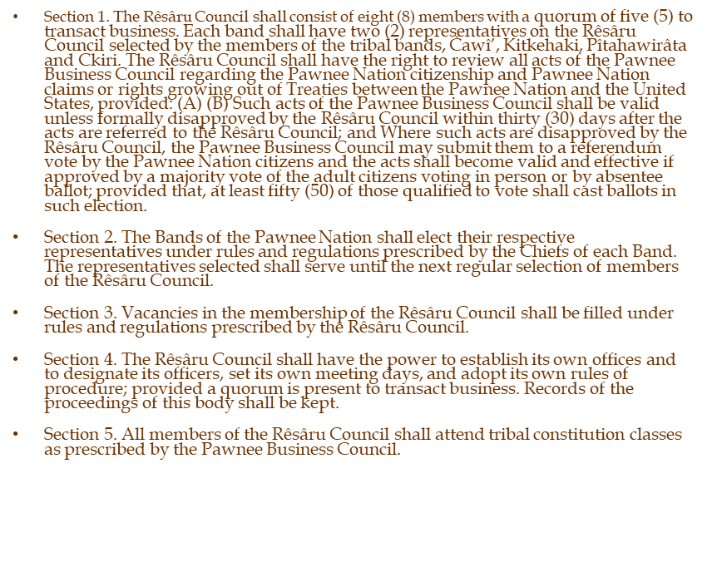
Amendment M (Clean)
To clean up this Article to make it easier to read and understand, and to incorporate the proper Pawnee language and dialect.
ARTICLE VIII - RÊSÂRU COUNCIL

Slide 26
Amendment N - ARTICLE IX – COURTS (DRAFT)
Section 1. Establishment of Authority -–
Under its inherent sovereign authority, Tthe judicial power of the Pawnee Nation of Oklahoma shall be vested in the current Pawnee Nation Courts established by this Article Resolution 93-65 and shall consist of five (5) Judicial OfficersJustices and at least one (1) trial court, known as the Pawnee Nation District Court, and additional courts as may be established by tribalPawnee Nation law. The courts shall be a separate branch of government.
Section 2. Jurisdiction
The Courts of the Pawnee Nation of Oklahoma shall be courts of general jurisdiction and shall further have jurisdiction in all cases or controversies arising under thePawnee Nation Treaties, this cConstitution, or as provided by Pawnee Nation laws or in equity, and treaties of the Pawnee Nation of Oklahoma. The Pawnee Nation Supreme Court shall have original jurisdiction in only such cases as may becases and controversies as provided by law or in equity, and shall have appellate jurisdiction in all other cases.
Section 3. Selection of Judicial Officers –
The Judges of the District Courts and the Justices of the Pawnee Nation Supreme Court and Judges of District Courts shall be selected and appointed by a majority vote of the Business Council. Justices and JudgesJudges and Justices may, by Supreme Court rRule, assume the duties of a member of the other court to hear a specific case in which the regular Judge or Justices or Judges are is disqualified or areis otherwise unable to perform his/hertheir duty as to the case. Provided, no Judge or Justice shall preside over a matter in the Pawnee Nation Supreme Court if he/she presided over the same matter in the Pawnee Nation District Court.
Section 4. Term of Office –
The Judges and Justices and Judges of the Pawnee Nation of Oklahoma shall serve terms according to Pawnee Nation law six year terms beginning aton the date of theirhis/her confirmationappointment in office and continueing if reconfirmed or until his/hertheir successor shall behas been duly appointed and confirmed and installed.
Section 5. Removal –
Judges and Justices and Judges of the Pawnee nNation of Oklahoma may be removed from office only by a majority vote of the other active Judges and Justices and Judges sitting together upon a showing of habitual neglect of the duties of office, oppression in office for personal gain or advantage, or for cause as defined in Article VII, Section 4 (C), D. In no case may a judicial officer be removed from office because of his/her decision in any case before the Court.
Section 6. Judicial Review –
The Pawnee Nation Courts are specifically authorized to review, in any case properly before them, the actions of the Pawnee Business Council, or any other officers, agents, or employees of the government of the Pawnee Nation of Oklahoma to determine whether those actions are prohibited by Federal law, this Cconstitution or the laws of the Pawnee Nation of Oklahoma. If the action complained of is outside the scope of authority delegated to entity in question, or if a proper authority is being exercised in a prohibited manner, Tthe Courts may enter an injunction or other proper equitable relief or declare the action unconstitutional and void as justice may require.
Section 7. Effective date, Interim ProvisionSeparation of Powers – This article shall be effective upon approval in accord with Article X.
The Pawnee Nation cCourts shall be a separate branch of government. The Pawnee Business Council shall thereafter have the authority to enact such laws as may be necessary for the full and proper functioning of the Courts of the Pawnee Nation of Oklahoma which are not inconsistent with this aArticle. All existing current laws regarding the cCourts shall remain in effect and asmay be amended to the extent that they do not conflict with this Constitution.
Section 8. Court Funding –
The Pawnee Nation Courts shall be funded in a reasonable amount in the annual budget in an amount equal to or exceeding funding from the previous fiscal year. In the event thatIf overall funding shortfalls require budget cuts, the cCourt budget may be reduced but proportionately not more than any other departmentbrand of government.
Court funding shall be equal to or exceed funding amounts for fiscal year 2007.
In the event that overall funding shortfalls require budget cuts, the court budget may be reduced but proportionately not more than any other department.

Slide 27
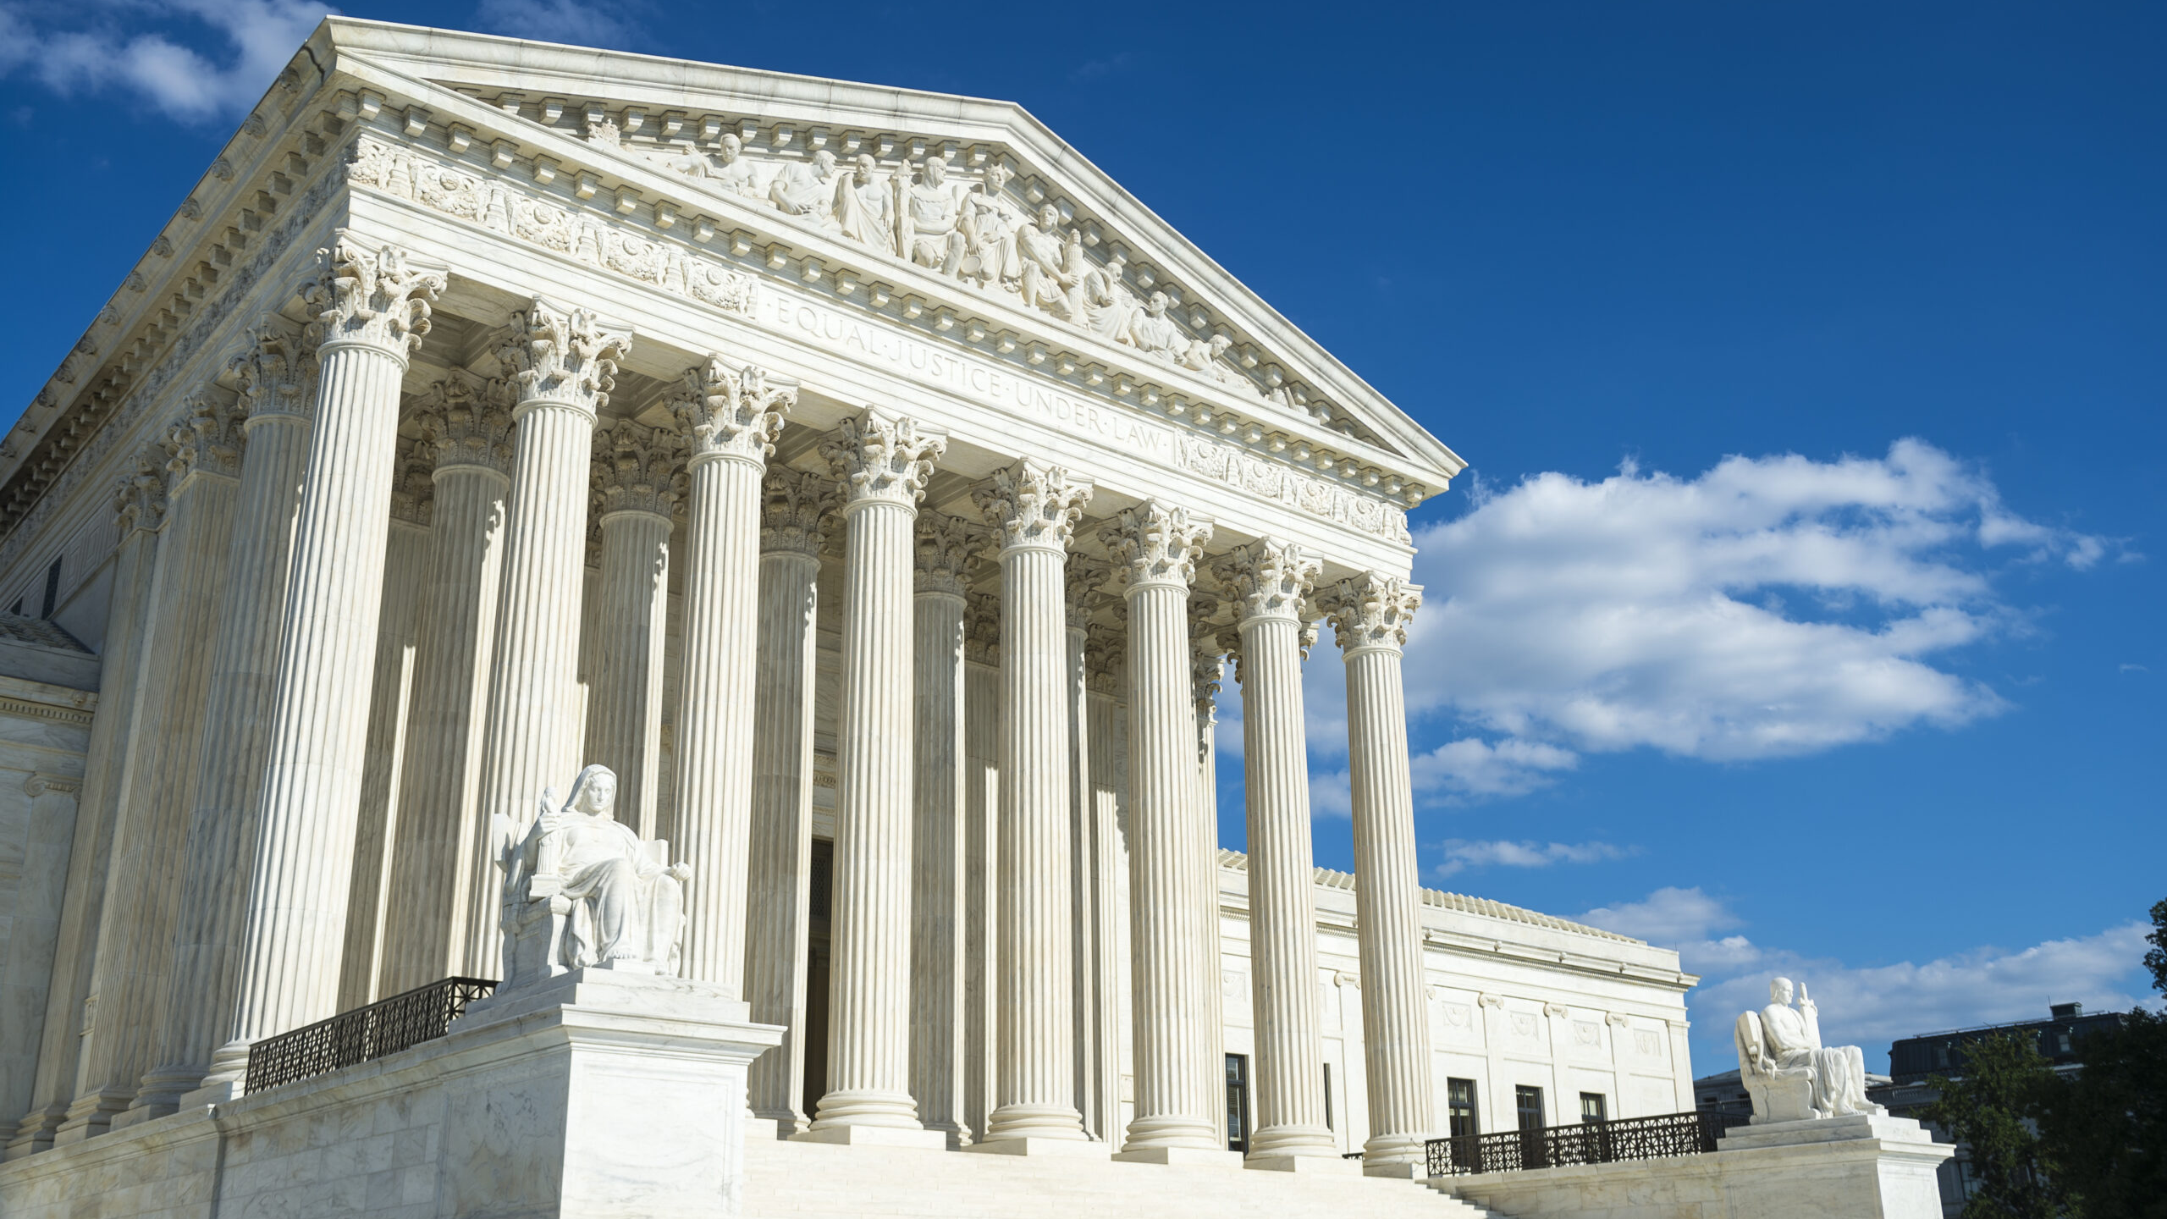
Amendment N (Clean)
To clean up this Article to make it easier to read and understand; confirm the separation of powers; and clarify court authority, jurisdiction, court funding, and budgets.
ARTICLE IX - COURTS

Slide 28
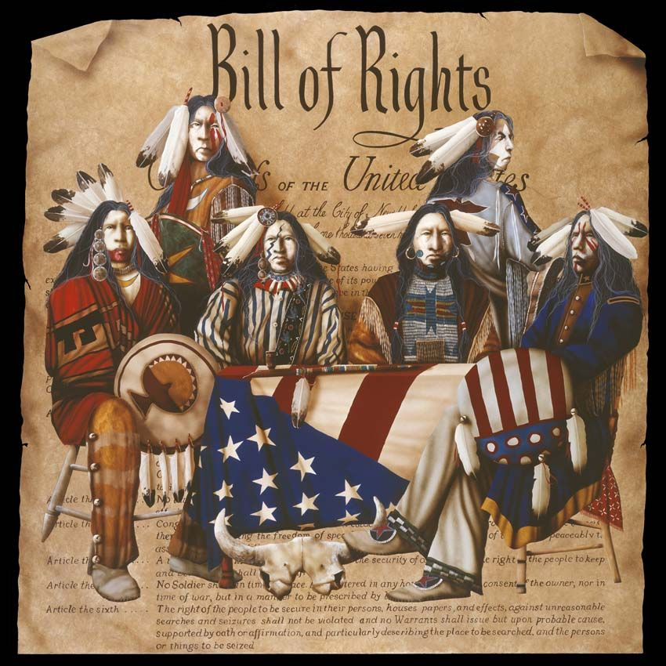
Amendment O(Draft)
Section 1. All members citizens of the Pawnee Nation shall enjoy, without hindrance, freedom of worship, conscience, speech, press, assembly, and association, and the right to a clean and sustainable environment.
Section 2. Thise Constitution shall not in any way alter, abridge or otherwise jeopardize the rights and privileges of the Pawnee Nation or its citizens as citizens of the United States or of any State State of Oklahoma or of the United States. The Indian Civil Rights Acts (ICRA) of 1968 (ICRA) and the rights guaranteed under this ActConstitution is applicable to theall tribal members and citizens and other persons subject to within tribal Pawnee Nation jurisdiction.
Section 3. The individual property rights of any member citizen of the Pawnee Nation shall not be altered, abridged or otherwise affected by the provisions of this Constitution and By-Laws without the consent of such individual membercitizen.
Section 4. The enumeration in the Constitution of the Pawnee Nation of certain rights shall not be construed to deny or disparage other rights retained by Pawnee Nation citizens.
Section 5. No citizen of the Pawnee Nation, eighteen (18) years of age or older, shall be denied the right to vote by secret ballot, either in person or by absentee ballot, provided that no write-in votes shall be allowed.
Section 6. Pawnee Nation Citizens shall have the inherent right to preserve and foster their historic, linguistic and cultural lifeways. The Pawnee Nation shall protect and promote the language, culture, and traditional ways of all Pawnee people.
ARTICLE X - BILL OF RIGHTS

Slide 29
Amendment O(Clean)
Section 1. All citizens of the Pawnee Nation shall enjoy, without hindrance, freedom of worship, conscience, speech, press, assembly, association, and the right to a clean and sustainable environment.
Section 2. This Constitution shall not in any way alter, abridge, or otherwise jeopardize the rights and privileges of the Pawnee Nation or its citizens as citizens of the United States or of any State. The Indian Civil Rights Act (ICRA) of 1968 and the rights guaranteed under this Constitution are applicable to all tribal members and citizens and other persons subject to Pawnee Nation jurisdiction.
Section 3. The individual property rights of any citizen of the Pawnee Nation shall not be altered, abridged, or otherwise affected by the provisions of this Constitution without the consent of such individual citizen.
Section 4. The enumeration in the Constitution of the Pawnee Nation of certain rights shall not be construed to deny or disparage other rights retained by Pawnee Nation citizens.
Section 5. No citizen of the Pawnee Nation, eighteen (18) years of age or older, shall be denied the right to vote by secret ballot, either in person or by absentee ballot, provided that no write-in votes shall be allowed.
Section 6. Pawnee Nation Citizens shall have the inherent right to preserve and foster their historical, linguistic, and cultural lifeways. The Pawnee Nation shall protect and promote the language, culture, and traditional ways of all Pawnee people.
To revise this Article to make it easier to read and understand; protects the Pawnee people’s most important individual rights and freedoms; confirms the right to vote; ensures citizens’ inherent rights to preserve, promote, and practice language, culture, and traditions of the Pawnee Nation.
ARTICLE X - BILL OF RIGHTS

Slide 30
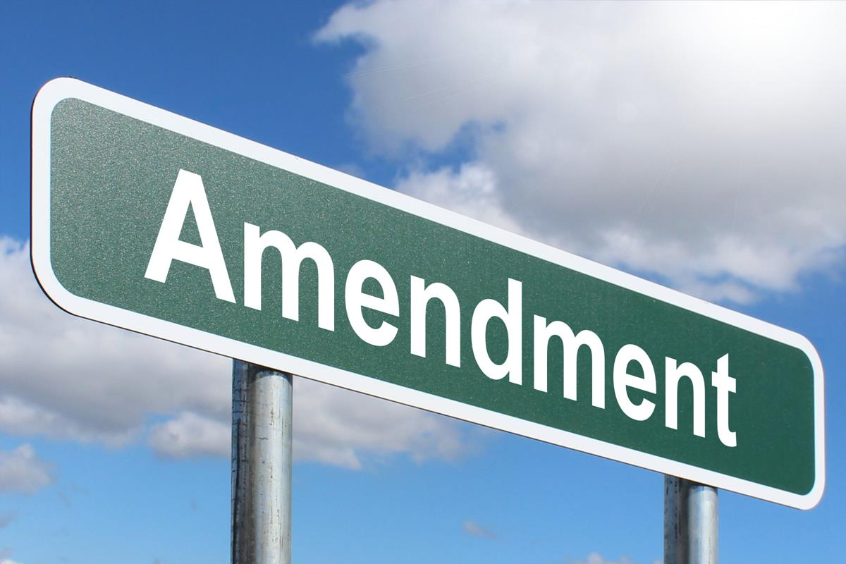
Amendment P(Draft)
Section 1. Amendments to this Constitution may be proposed by a majority vote of the Pawnee Business Council or by a petition signed by at least two percent (2%) fifty (50) of the adult citizensmembers of the Pawnee Nation of Oklahoma.
Section 2. This Constitution may be amended by a majority vote of the qualified voters of the Pawnee Nation voting in an election called for that purpose by the Pawnee Business Council Secretary of Interior and conducted pursuant to the rules and regulations of the Pawnee Nation of Oklahoma. Provided, that, at least four percent (4%)fifty (50) of those qualified to vote shall cast ballots in such election.
Section 3. TheAn amendment shall become effective when the vote is certified by the Election Commission and submitted to the Secretary of the Pawnee Business Council.approved by the Secretary of Interior, so long as such approval is required by Federal law, and ratified by the adult members of the Nation.
ARTICLE XI - AMENDMENTS

Slide 31
Amendment P (Clean)
Section 1. Amendments to this Constitution may be proposed by a majority vote of the Pawnee Business Council or by a petition signed by at least two percent (2%) of the adult citizens of the Pawnee Nation.
Section 2. This Constitution may be amended by a majority vote of the qualified voters of the Pawnee Nation voting in an election called for that purpose by the Pawnee Business Council and conducted pursuant to the rules and regulations of the Pawnee Nation. Provided that at least four percent (4%) of those qualified to vote shall cast ballots in such election.
Section 3. An amendment shall become effective when the vote is certified by the Election Commission and submitted to the Secretary of the Pawnee Business Council.
To clean up this Article to make it easier to read and understand; and remove the requirement for Secretarial approval may be removed through a Secretarial election (25 CFR Part 81).If removed, Secretarial approval of future amendments will not be required meaning there will be no future Secretarial elections conducted for the Nation, and future elections will be governed and run by the Nation, rather than the BIA.
ARTICLE XI - AMENDMENTS

Slide 32

Amendment Q(Draft)
ARTICLE XII - PLACE OF MEETINGS
Unless some other location in the Pawnee Nation of Oklahoma jurisdiction is designated in the notice, all meetings of the Pawnee Business Council and of the NasharoRêsâru Council shall be held, in person or virtual, at the Pawnee Nation Reserve at Pawnee, Oklahoma.

Slide 33
Amendment Q(Clean)
Unless some other location in the Pawnee Nation jurisdiction is designated in the notice, all meetings of the Pawnee Business Council and of the Rêsâru Council shall be held, in person or virtual, at the Pawnee Nation Reserve at Pawnee, Oklahoma.
To clean up this Article to make it easier to read and understand; include provision for meetings in person or virtual; and incorporate Pawnee language and dialect
ARTICLE XII - PLACE OF MEETINGS

Slide 34
Amendment R
CURRENT AND PROPOSED (CLEAN)
ARTICLE XIII - ADOPTION
ARTICLE XIII - SAVINGS CLAUSE
This Constitution when approved by the Secretary of Interior, shall be submitted to referendum vote of the adult members of the Nation, and shall become effective if approved by two-thirds vote of the adult members voting in person, provided that at least fifty votes are cast.
All enactments of the Pawnee Nation adopted before the effective date of this Constitution shall continue in effect to the extent that they are not inconsistent with this Constitution.
To remove the Adoption Article requiring approval by the Secretary of the Interior to amendments of the Pawnee Nation Constitution; and replace with the Savings Clause (originally Article XIV), which is designed to preserve certain rights, duties, or privileges that might otherwise be destroyed prior to the amendment to the current Nation’s Constitution

Slide 35
Amendment S
CURRENT: ARTICLE XIV - SAVINGS CLAUSE
All enactments of the Nation adopted before the effective date of this Constitution shall continue in effect to the extent to that they are not inconsistent with this constitution.
PROPOSED (CLEAN): ARTICLE XIV – SEVERABILITY
If any provision of the Pawnee Nation Constitution shall, in the future, be declared invalid or unconstitutional or in violation of Federal or Pawnee Nation law, it is the intent of the Pawnee Nation that the invalid portion shall be severed and the remaining provisions shall remain in full force and effect.
To replace Article XIV, originally Savings Clause, with Severability; continue to allow the Constitution to be preserved in the event that one Article or Article section is declared invalid or unconstitutional or in violation of Federal or Pawnee Nation law; update previous Severability Article to include Pawnee Nation law and the intent of the Nation that the remaining provisions/Articles remain in full force and effect. .​
ARTICLE XIV

Slide 36
Amendment T
ARTICLE XV – SEVERABILITY (CURRENT)
If any part of this Constitution is held by the Federal Court to be invalid or contrary to the U.S. Constitution or Federal law, the remainder shall continue to be in full force and effect.
ARTICLE XV – SOVEREIGN IMMUNITY PROPOSED (CLEAN)
In fully exercising its self-determination and sovereign powers, the Pawnee Nation shall be immune from suit except to the extent that the Pawnee Business Council expressly waives the Nation’s sovereign immunity or as provided by in this Constitution.
To replace XV Severability with XV Sovereign Immunity; establish the Nation’s protection from lawsuits, confirm that this immunity can only be removed if the PBC itself expressly waives immunity or if Congress has explicitly authorized a suit against the Nation.

Slide 37
YOUR VOTE MATTERS
THE PAWNEE NATION CONSTITUTION CONVENTION DELEGATES THANK YOU!

